Slide 1
RateMyFit: One Stop Fashion
Tanishq Kr Toliya 221210107
Vansh Garg 221210118
Vaibhav Negi 221210117

Slide 2
What and Why?
Rate My Fit is a fashion app where users can upload photos of their outfits and receive feedback from others.
It's designed to help people get opinions on their outfits, improve their style, and share fashion ideas.
AI integrated features to generate outfit suggestions, ratings and feedback for anonymity.
Ability to surf other user's posts for inspiration.

Slide 3
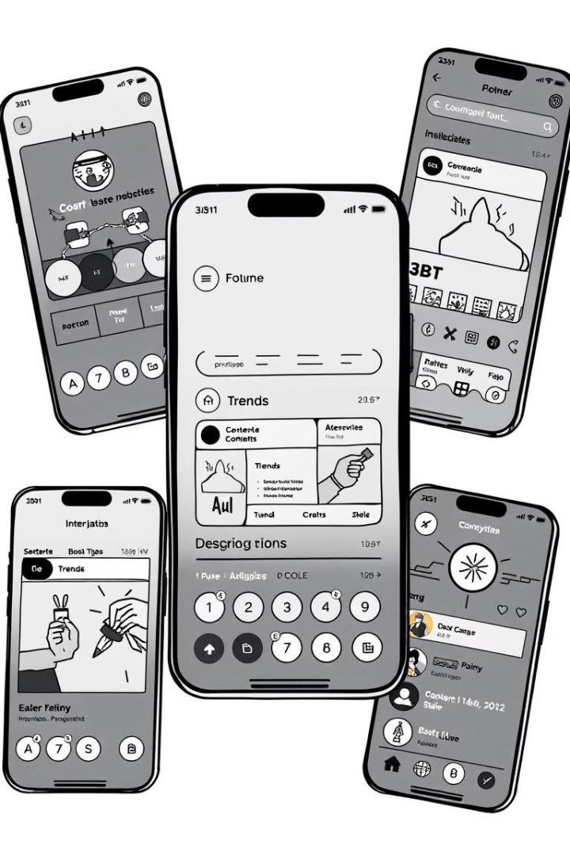
Features
1
Home Screen
2
Ai Suggestions
3
Create Posts
4
Trends section
5
Manage Profile

Slide 4
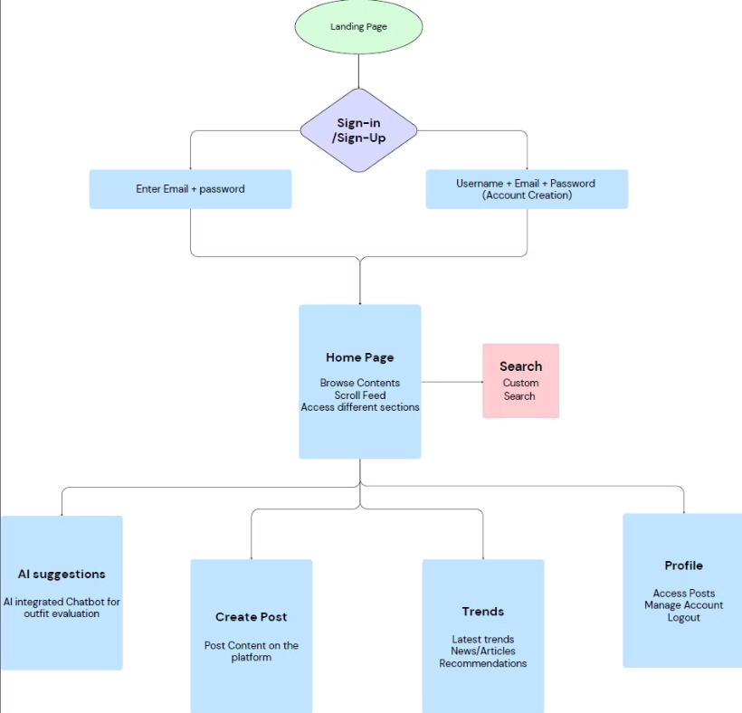
Flow

Slide 5
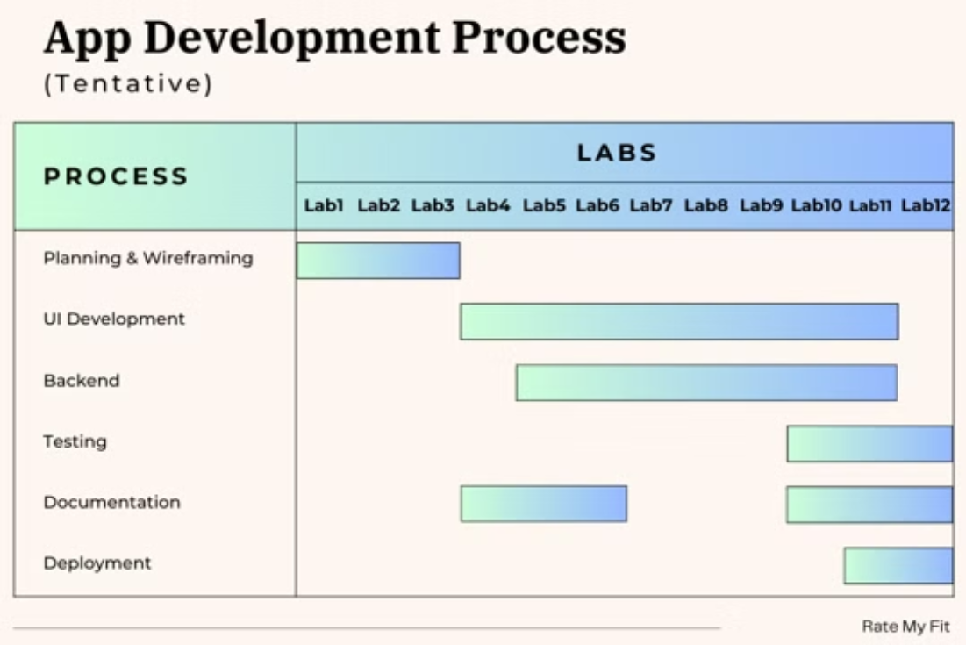
Timeline

Slide 6
Thank You
#RateMyFit

